Slide 1
Procedural terrain with Tessellation
Carkaxhija Nicola
Firenze, 24/07/2019

Slide 2
Procedural terrain with Tessellation
Firenze, 24/07/2019
Introduction
The procedural terrain task consists in synthesizing a pseudo-random realistic 3D texture that can potentially extent infinitely in real time as the camera moves, while tessellation is a technique that thickens a mesh of triangles by enabling the generation of new vertexes dynamically.
Tessellation is well suited for procedural terrain: since an highly detailed model requires more triangles and processing, when rendering at long distance it’s reasonable to use fewer details and reserve more resources to process the objects closer to the camera, whose small details are noticeable.

Slide 3
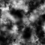
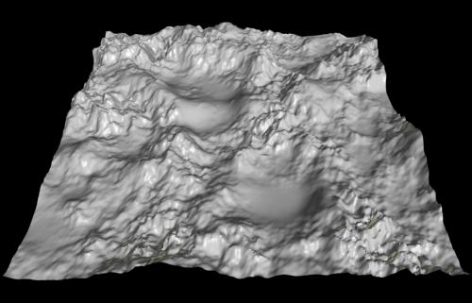
Procedural terrain with Tessellation
Firenze, 24/07/2019
Procedural terrain
The simplest generation method is based on the definition of an heightmap, a 2D grid whose values represent the terrain altitude. It may be interpreted and visualized as a greyscale picture, as illustrated below both in a flat and a 3D view.

Slide 4
Procedural terrain with Tessellation
Firenze, 24/07/2019
Value noise algorithm
Setting random numbers for each cell of the grid doesn’t work, as this leads to sudden changes in the ground. The generation has to be carried out so that there are smooth natural transitions between the points values.
For this purpose, the Value noise algorithm is used. It consists of 3 steps:
for each corner of the grid cells, a random gradient (2d vector) is generated;
at any pixel the difference vector with the 4 corners its cell lies in is computed;
gradients are projected on the difference vectors and the results are combined through bilinear interpolation.

Slide 5
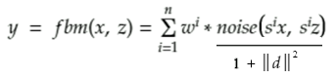
Procedural terrain with Tessellation
Firenze, 24/07/2019
Fractal Brownian Motion algorithm
To achieve more realistic results, it’s common practice to combine several outputs obtained by running the Value noise algorithm with different configurations, i.e. grid scales, and averaging the results according to the following equation:
Where y is the height, x and z the other two coordinates, w^{i} opportune weights and s the scale factor and d the discrete gradient in (x, z).
Specifically, when w and s are set to 0.5 the components are called octaves and this is known as Fractal Brownian Motion (FBM) algorithm.

Slide 6
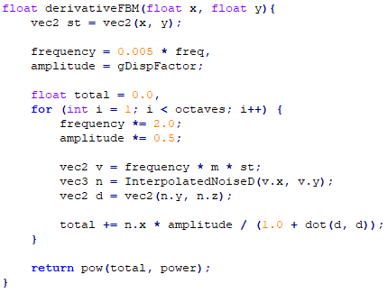
Procedural terrain with Tessellation
Firenze, 24/07/2019
Fractal Brownian Motion algorithm

Slide 7
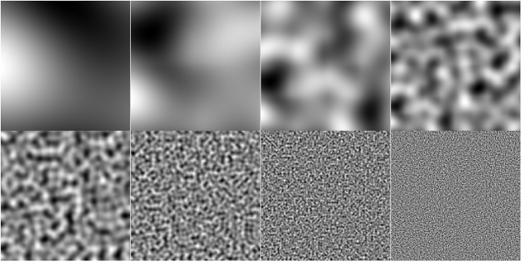
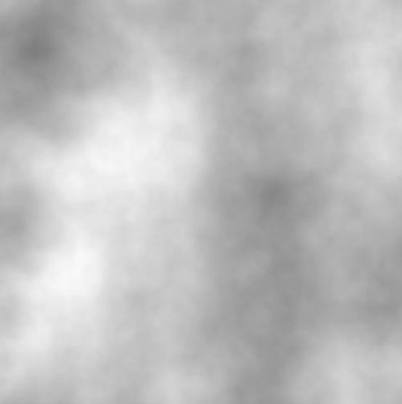
Procedural terrain with Tessellation
Firenze, 24/07/2019
Fractal Brownian Motion algorithm

Slide 8
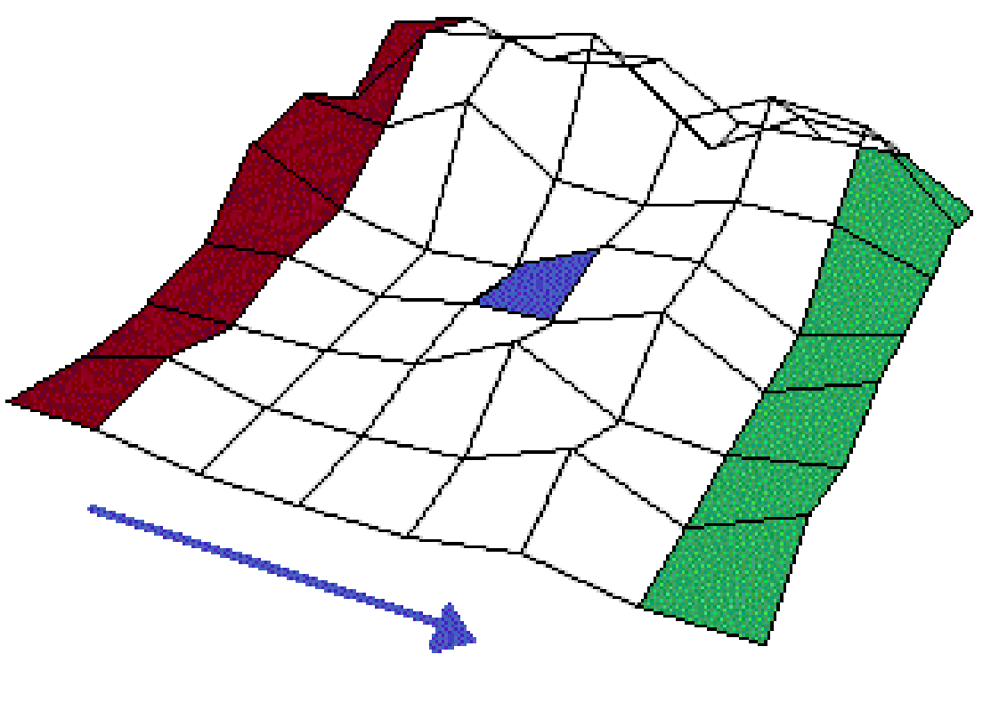
Procedural terrain with Tessellation
Firenze, 24/07/2019
Scene structure
The scene is based on a square grid whose dimension is set by the user at runtime. As the camera moves along a direction and crosses the central tile, an opportune offset equal to the tile length is applied to all the positions: the result is equivalent to adding a row on its way on the top of the grid, whilst another one is removed from the opposite side, so that the camera is always located in the central tile.

Slide 9
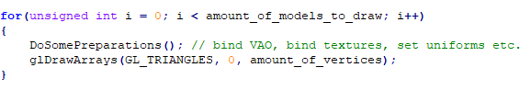
Procedural terrain with Tessellation
Firenze, 24/07/2019
Instancing
To render a large amount of objects the classic code consists of a drawing loop:
All those rendering calls invoked at each frame drastically reduce performances, since OpenGL carries out preliminary operations before drawing the vertex data, such as indicating the GPU which buffer to read data from and where to find vertex attributes, and this happens over the relatively slow CPU to GPU bus.

Slide 10
Procedural terrain with Tessellation
Firenze, 24/07/2019
Instancing
To handle a large grid in a reasonable amount of time, an alternative approach has been adopted, that is sending data over the GPU only once and make OpenGL drawing multiple objects with a single call, a practice known as instancing. As a consequence, the previous “draw for” has been replaced with the following:
By doing so, the continuous communication between CPU and GPU previously made each time to render an object now is done only once by using a new version of the render call: glDrawElementsInstanced.

Slide 11
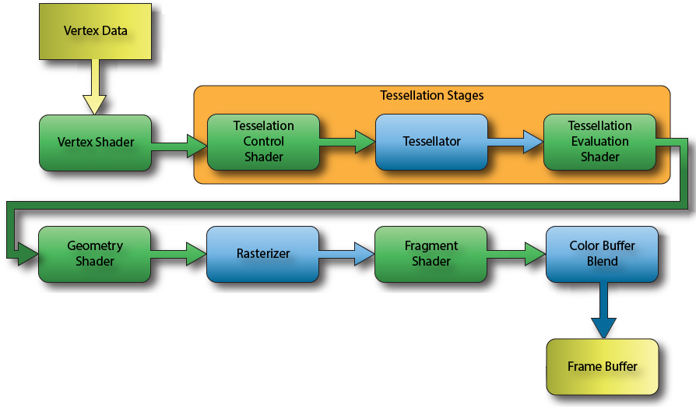
Procedural terrain with Tessellation
Firenze, 24/07/2019
OpenGL 4 Pipeline

Slide 12
Procedural terrain with Tessellation
Firenze, 24/07/2019
Tessellation
Tessellation is a feature introduced in OpenGL 4.0, consisting of 3 stages placed between the Vertex and Geometry Shader:
- the Tessellation Control Shader (TCS), responsible for determining the patch tessellation level;
- the Tessellator, that establishes how to generate the new vertices, in which order, and what kind of primitives to build out of them;
- the Tessellation Evaluation Shader (TES), that takes the tessellated and computes the attributes of the new vertex.

Slide 13
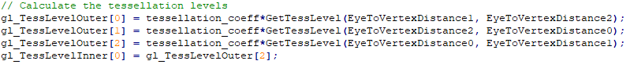
Procedural terrain with Tessellation
Firenze, 24/07/2019
Tessellation Control Shader
The tessellation granularity is specified by two parameters:
the outer tessellation level, i.e. in how many edges one is split in;
the inner tessellation level, that determines the number of new vertices placed inside a triangle.
Both are computed on the base of the triangles distance from the camera: the closer they are, the higher will be the tessellation level.

Slide 14
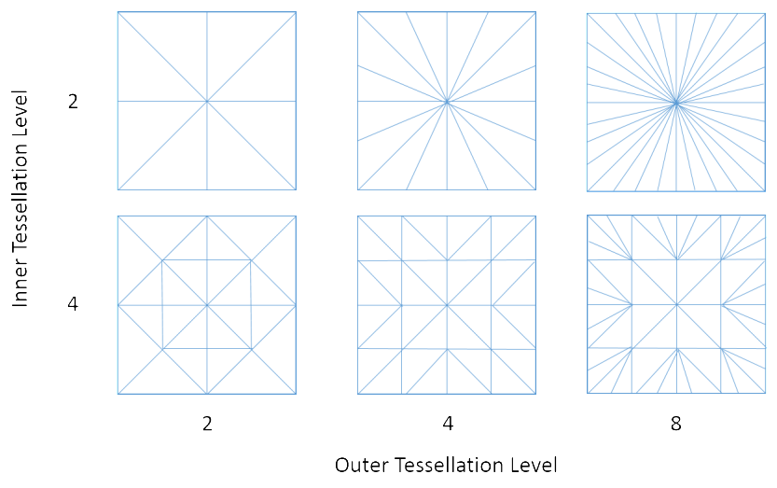
Procedural terrain with Tessellation
Firenze, 24/07/2019
Tessellation Control Shader

Slide 15
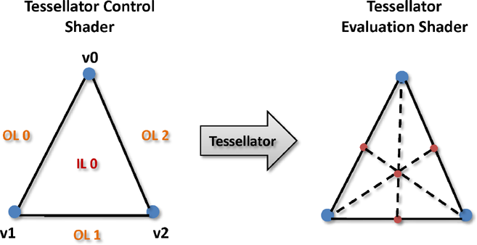
Procedural terrain with Tessellation
Firenze, 24/07/2019
Tessellator
On the base of the inner and outer tessellation levels provided by the TCS, the Tessellator generates “abstract patches”, so called because the actual vertex data, such as position and colour, is to be generated by the TES. The new vertex here computed are expressed in barycentric coordinate with respect to the patch they are contained in.

Slide 16
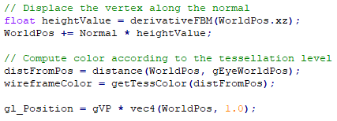
Procedural terrain with Tessellation
Firenze, 24/07/2019
Tessellation Evaluation Shader
The Tessellation Evaluation Shader (TES) is invoked for each tessellation coordinate generated in the previous stage, for which it determines the attributes.
Particularly, it first computes the actual position respect the World Coordinate Frame on the base of the barycentric coordinate, then the height is determined as described in the FBM section:

Slide 17
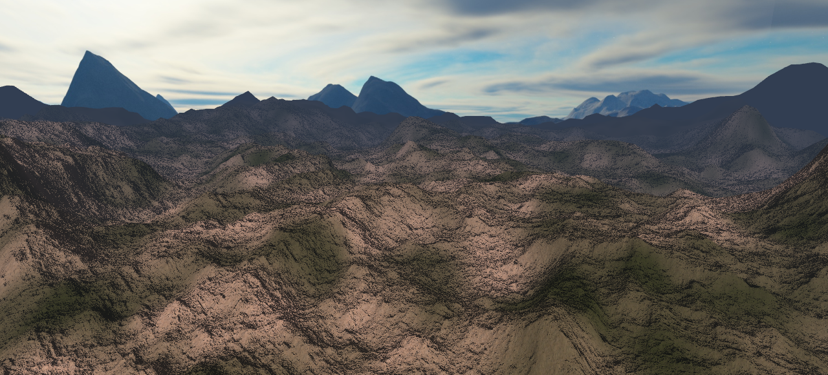
Procedural terrain with Tessellation
Firenze, 24/07/2019

Slide 18
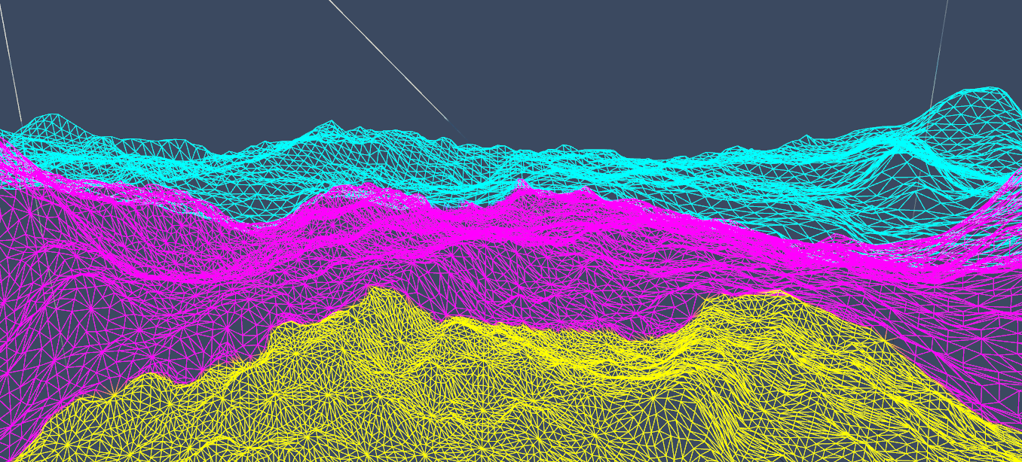
Procedural terrain with Tessellation
Firenze, 24/07/2019

